Slide 1
Efficient molecular similarity match using Elasticsearch
Konstantin Perikov
Cambridge Cheminformatics Network Meetings
November, 2020
Notes:
Hello, today we going to have a talk about efficient molecular similarity match using Elasticsearch. It will be a blend of chemistry and applied programming that helping us to solve problems

Slide 2
About speaker
Advanced software engineer interested in algorithms, information retrieval, functional programming and practical machine learning
Deeply fascinated by DataScience and ML, combining classical information retrieval with advanced NLP/NLU techniques
Part of the Top 5% Stack Overflow answerers in Lucene, Elasticsearch, Solr, part of the top 10% Stack Overflow answerers in Java technology
Konstantin Perikov
Chief Software Engineer
Notes:
I’m Konstantin Perikov, Chief Software Engineer at EPAM, proud to be a part of Advanced Software Engineer track – community of the highly talented and experienced software engineers, who are solving the problems that are impossible to google ☺
My main area of expertise is information retrieval and its practical applications in different business domains like ecommerice, publishing, patents, and many others.
I’m a firm believer in open source technology and like to contribute there as much as possible

Slide 3
Disclaimer: Cheminformatics 101
Notes:
Before we get started I need to read this disclaimer, I’m not a chemist, I don’t have any chemical degree please forgive me if I would misuse some scientific terms during my presentation
I’m still learning and trying hard to be more proficient in this field

Slide 4
Agenda
Molecule representation
What is chemical similarity and why it’s important
Elasticsearch based operations on fingerprints
Conclusion
Notes:
Agenda for today

Slide 5
Molecule representation
1
Ways to identify chemical compound

Slide 6
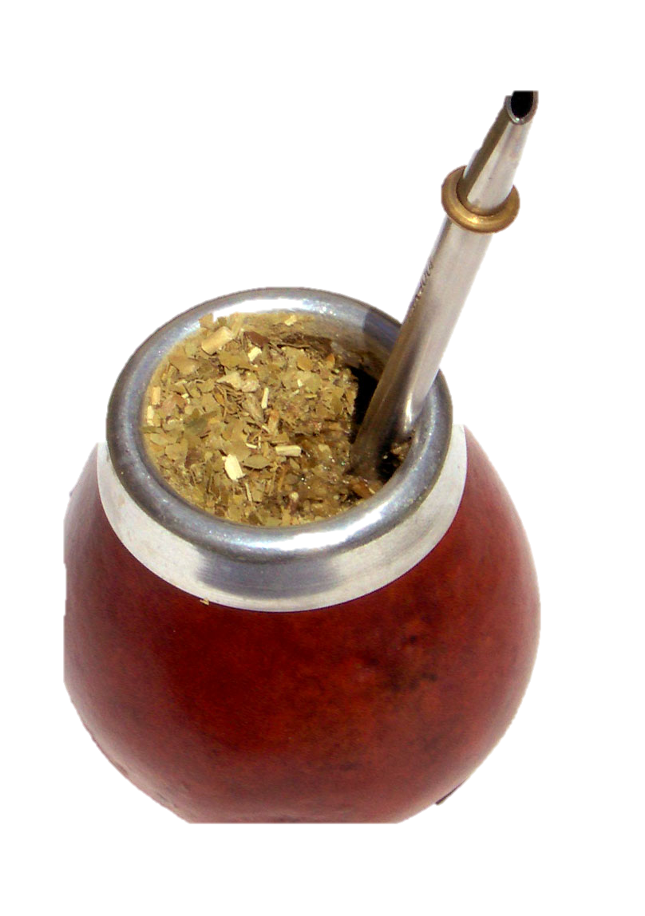
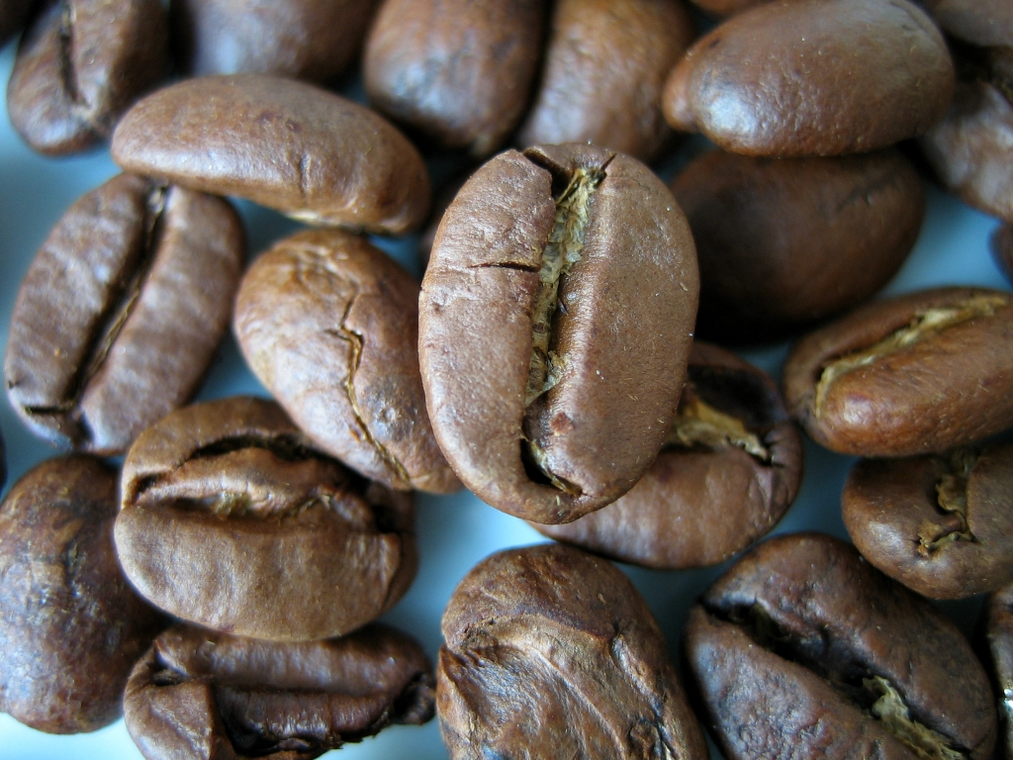
Classical chemical representations
Molecular formula for caffeine - C₈H₁₀N₄O₂
IUPAC name - 1,3,7-Trimethylpurine-2,6-dione
Notes:
Molecular formulae indicate the simple numbers of each type of atom in a molecule, with no information on structure. For example, the empirical formula for glucose is CH₂O (twice as many hydrogen atoms as carbon and oxygen), while its molecular formula is C₆H₁₂O₆ (12 hydrogen atoms, six carbon and oxygen atoms).
Structural formula on the other side not only counts number of atoms, but also provide information about complete geometric representation of the molecular structure

Slide 7
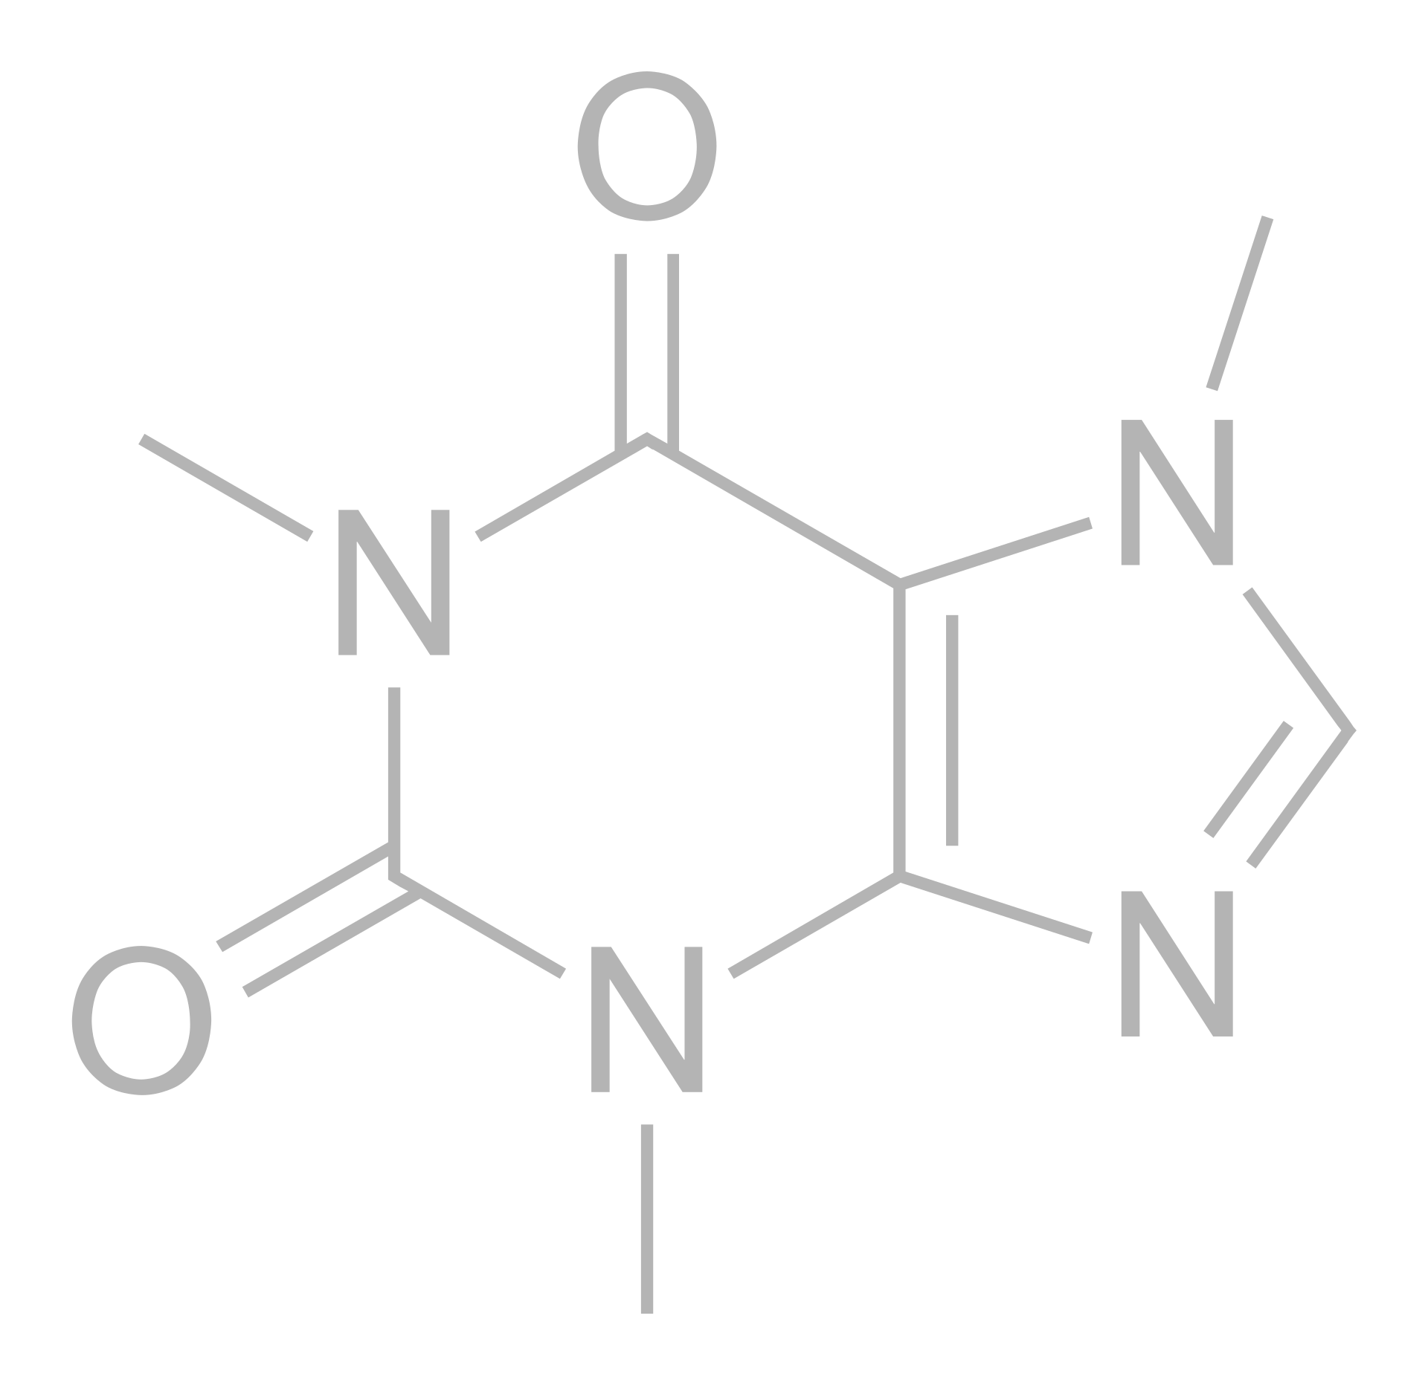
Structural formula for caffeine
Notes:
Oof the most important ones – structural formula
The structural formula of a chemical compound is a graphic representation of the molecular structure (determined by structural chemistry methods), showing how the atoms are possibly arranged in the real three-dimensional space. The chemical bonding within the molecule is also shown, either explicitly or implicitly. Unlike chemical formulas, which have a limited number of symbols and are capable of only limited descriptive power, structural formulas provide a more complete geometric representation of the molecular structure.

Slide 8
Other ways to represent caffeine
Molecular formula - C₈H₁₀N₄O₂
IUPAC name - 1,3,7-Trimethylpurine-2,6-dione
SMILES - CN1C=NC2=C1C(=O)N(C(=O)N2C)C
InChI=1S/C8H10N4O2/c1-10-4-9-6-5(10)7(13)12(3)8(14)11(6)2/h4H,1-3H3
etc.
Notes:
Apart from molecular and structural formula there are several chemical naming formats like SMILES, InChi, CML and others

Slide 9
Drug design & Chemical similarity
2
What it is and why it’s important?

Slide 10
Drug discovery approaches
Drug design
Structure based
Ligand based
Notes:
There are two major types of drug design. The first is referred to as ligand-based drug design and the second, structure-based drug design.
Structure-based drug design (or direct drug design) relies on knowledge of the three dimensional structure of the biological target
Ligand-based drug design (or indirect drug design) relies on knowledge of other molecules that bind to the biological target of interest. These other molecules may be used during drug design later
Of course there are hybrid ways as well
So, for ligand based it is very important to have a notion of close molecule to the existing ones

Slide 11
Chemical similarity
- “Similar compounds have similar properties”
Concepts and Applications of Molecular Similarity, Gerald M. Maggiora, Mark A. Johnson, 1990
Notes:
Chemical similarity is a metric, that for given 2 molecules could produce a scalar number representing how close or similar those two are
Chemical similarity (or molecular similarity) refers to the similarity of chemical elements, molecules or chemical compounds with respect to either structural or functional qualities, i.e. the effect that the chemical compound has on reaction partners in inorganic or biological settings. Biological effects and thus also similarity of effects are usually quantified using the biological activity of a compound. In general terms, function can be related to the chemical activity of compounds (among others).
The notion of chemical similarity (or molecular similarity) is one of the most important concepts in chemoinformatics.^{[1][2]} It plays an important role in modern approaches to predicting the properties of chemical compounds, designing chemicals with a predefined set of properties and, especially, in conducting drug design studies by screening large databases containing structures of available (or potentially available) chemicals. These studies are based on the similar property principle of Johnson and Maggiora, which states: similar compounds have similar properties.^{[1]}

Slide 12
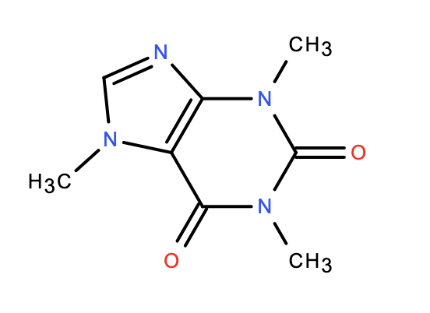
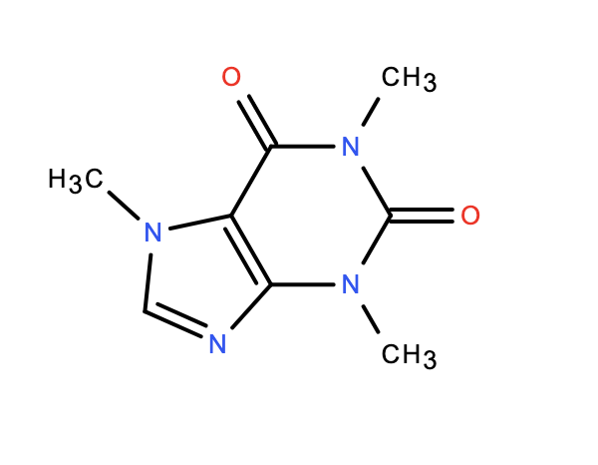
Complexity of graph representation
Caffeine - C₈H₁₀N₄O₂
CN1C=NC2=C1C(=O)N(C(=O)N2C)C
CN1C(=O)C2=C(N=CN2C)N(C)C1=O
Notes:
One thing which I didn’t yet tell you, is that technically since SMILES is a linear representation of the atoms of structural formula by doing DFS on the chemical graph and guess what, different SMILES could still be the same compound as on example here
Same compound, different smiles, different (slightly in this case) graph.
Similarity problem just became even more complex, yes one could say – there is a canonical SMILES version, which is trying to fight this problem, still not enough Molecular formula the same, but smiles are different

Slide 13
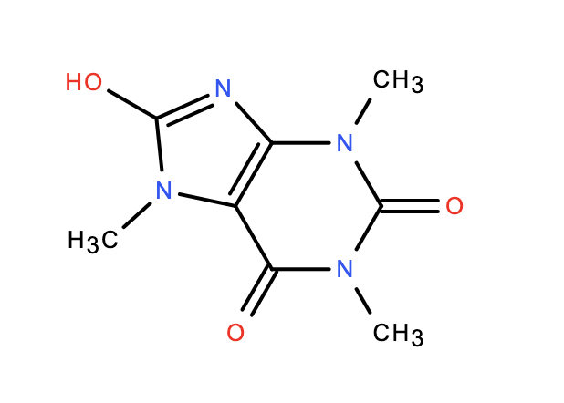
What if only part of the molecule is the same?
CN1C=NC2=C1C(=O)N(C(=O)N2C)C
CN1C2C(N(C)C(N(C)C=2N=C1O)=O)=O
Notes:
Another example is, imagine that our molecule – in our case caffeine, but we have additional functional group?
All these example that we have, are clearly were close or similar molecules. Let’s define similarity relationship for the molecules

Slide 14
Elastic Chemical API
3
Let’s talk about tech details
Notes:
So, after we did a short recap on what’s similarity and why it’s important – lets take a look at what we did
What we build is an Java and Python based API for Elasticsearch that have ability to load different file formats like SDF, Mol ,Smiles into Elasticsearch
Construct targets and run similarity, substructure and exatch matches against it
As an additional features we have a highly efficient search based on non-chemical fields – like names, tags (text), number values of bioactivity etc

Slide 15
Why we chose Elasticsearch?
Elasticsearch is a distributed, open source search and analytics engine for all types of data, including textual, numerical, geospatial, structured, and unstructured. Elasticsearch is built on Apache Lucene Java library
Standard de-facto tool for information retrieval
Notes:
Why we choose Elastic? For it’s ability to work efficiently with full text search, it’s open source (means free), it’s popular, it is available in most of the popular clouds providers as SaaS, it’s one of the most popular full text search engine based on Lucene Java library
We also targeted Elastic API only in order to minimized potential efforts for installing possible cartridges, plugins, limiting the need for custom development and increasing the value out of SaaS solutions

Slide 16
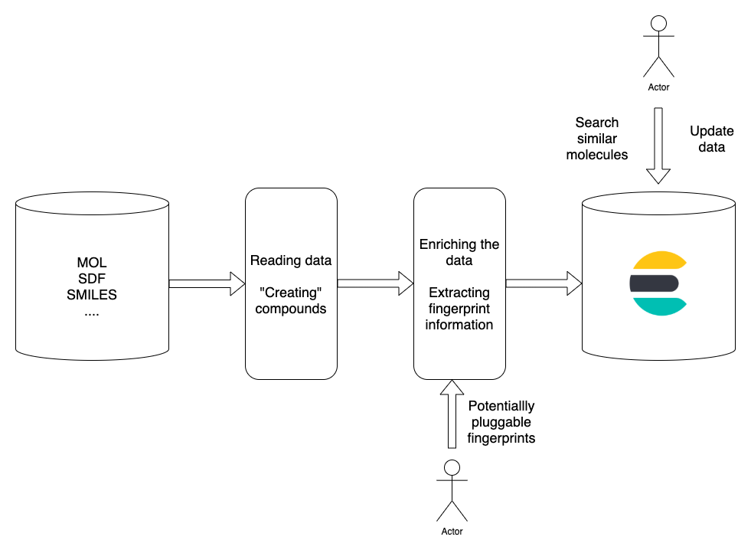
Architecture
Notes:
Why we choose Elastic? For it’s ability to work efficiently with full text search, it’s open source (means free), it’s popular, it is available in most of the popular clouds providers as SaaS, it’s one of the most popular full text search engine based on Lucene Java library
We also targeted Elastic API only in order to minimized potential efforts for installing possible cartridges, plugins, limiting the need for custom development and increasing the value out of SaaS solutions

Slide 17
Elastic Chem API
We built API based on Stream API introduced in Java 8
We are using Python 3.7+ (type hints, dataclassses (didn’t use yet))
Java Documentation - https://github.com/epam/Indigo/blob/master/api/plugins/bingo-elastic/java/README.md
Python Documentation –
https://github.com/epam/Indigo/blob/master/api/plugins/bingo-elastic/python/README.md
…should be available in Maven Central and PyPi pretty soon!
Notes:
There are several formats supported to represent molecule – SDF, Mol, SMILES etc
Read each molecule and create a series of fingerprints based on the structural representation
Load into Elasticsearch
Dependencies – easy to install, pick it up Elastic, docker-compose, or cloud service

Slide 18
Elastic Chem API – Available to install
As of today this API available in PyPi and Maven Central
Notes:
There are several formats supported to represent molecule – SDF, Mol, SMILES etc
Read each molecule and create a series of fingerprints based on the structural representation
Load into Elasticsearch
Dependencies – easy to install, pick it up Elastic, docker-compose, or cloud service

Slide 19
Stream API + Elastic process
Initially you are creating a Stream - sequence of elements supporting sequential operations
Even more we compose a stream pipeline, which consists of source (backed by ElasticRepository in our case), intermediate operations (similarity match, exact match, filter by full text queries) and terminal operation (in our case only collect is supported for now), which is actually triggering the execution (HTTP call in our case)
Streams are lazy by nature
Notes:
Why we choose Elastic? For it’s ability to work efficiently with full text search, it’s open source (means free), it’s popular, it is available in most of the popular clouds providers as SaaS, it’s one of the most popular full text search engine based on Lucene Java library
We also targeted Elastic API only in order to minimized potential efforts for installing possible cartridges, plugins, limiting the need for custom development and increasing the value out of SaaS solutions

Slide 20
How fingerprints are stored internally in Elasticsearch
Let’s imagine that we have simple 3 compounds, each of them have a simple fingerprints as following:
Compound 1
1010101….
Compound 2
1100110….
Compound 3
0011101….

Slide 21
How fingerprints are stored internally in Elasticsearch
Internally we going to have an efficient structure that would look like this:
1
Compound 1
Compound 2
2
Compound 2
3
Compound 1
Compound 3
4
Compound 3
5
Compound 1
Compound 2
Compound 3
6
Compound 2
7
Compound 1
Compound 3
Notes:
This is an example of the data structure, which is internally called a postings list, and of course it’s not a docs/compounds stored, but rather their ids only
Big query with a lot of bits requested could work fast based on bit sets intersections

Slide 22
How to do exact match of compound
Query Molecule
1010101….
1
$$∩$$
$$∩$$
$$∩$$
3
5
7
Additional exact match checker

Slide 23
How to do substructure match of compound
Query Molecule
1010101….
1
$$∩$$
$$∩$$
$$∩$$
3
5
7
Additional substructure match checker

Slide 24
How to do similarity match
Query Molecule
1010101….
1
$$∪$$
$$∪$$
$$∪$$
3
5
7
This approach would be efficient for similarity, where we had a threshold, which could be easily be converted into logical condition that if we want to have a metric higher than X, we would need at least Y clauses matched. In this case query execution will be even faster

Slide 25
EXAMPLE OF API CALLS
25

Slide 26
Create repository
Java
ElasticRepositoryBuilder<IndigoRecord> builder = new ElasticRepositoryBuilder<>();
repository = builder .withHostName("localhost") .withPort(9200) .withScheme("http") .build();
Python
repository = ElasticRepository(host="127.0.0.1", port=9200)

Slide 27
Index records from SDF file
Java
Iterable<IndigoRecord> records = Helpers.iterateSdf(“componds.sdf”);
repository.indexRecords(records, 1000);
Python
records = helpers.iterate_file(Path("compounds.sdf"))
repository.index_records(sdf);
Notes:
We have batch indexing support for efficient and fast input

Slide 28
Exact match
Java
List<IndigoRecord> exactRecords = repository.stream()
.filter(new ExactMatch<>(target))
.limit(20)
.collect(Collectors.toList())
.stream()
.filter(ExactMatch.exactMatchAfterChecker(target, indigo))
.collect(Collectors.toList());
Python
exact_records = repository.filter(exact=target, limit=20)
Notes:
Here is example of the API call to do exact match, we need to an after checker, since potentially fingerprints could be the same for different compounds (as with other hashing approaches)
Python code looks much more concise and we are thinking about bringing after checks into collect as well

Slide 29
Similarity match
Java
List<IndigoRecord> similarRecords = repository.stream()
.filter(new SimilarityMatch<>(target, 0.9))
.limit(20)
.collect(Collectors.toList());
Python
alg = SimilarityMatch(target, 0.9)
similar_records = repository.filter(similarity=alg, limit=20)
Notes:
By default SimilarityMatch is a Tanimoto one and we also have support for Tversky and Euclid metrics as well
We also have ability to specify a threshold on the metric - this would be very beneficial and produce even faster response time

Slide 30
Substructure match
Java
List<IndigoRecord> substructureMatchRecords = repository.stream()
.filter(new SubstructureMatch<>(target))
.limit(20)
.collect(Collectors.toList())
.stream()
.filter(SubstructureMatch.substructureMatchAfterChecker(target, indigo))
.collect(Collectors.toList());
Python
substructure_match_records = repository.filter(substructure=target)
Notes:
Same as with exact match, need to do a traverse of the graph

Slide 31
Custom fields support
Java
List<IndigoRecord> similarRecords = repository.stream()
.filter(new TanimotoSimilarityMatch<>(target))
.filter(new WildcardQuery<>("tag", “tes*”))
.collect(Collectors.toList());
Python
result = elastic_repository.filter(similarity=alg, bioactivity_value=RangeQuery(100, 1000))
Notes:
We have at the moment ability to filter by exact values for custom fields (ids, tags), wildcard query (something you could think of as regexp) and range requests on numeric fields with range of different values

Slide 32
Elastic Chem API is still under development
Future improvements we want to add:
API for different other languages (C#, etc?)
Support for Tautomer search (exact, substructure)
Support for gross formula search (based on number of atoms)
Marketplace integration for major cloud providers
Support for custom fingerprints
Suite of tools for working with Pubchem data in Elasticsearch
and hopefully much more…
Notes:
Marketplace

Slide 33
Conclusion
4
Notes:
As a conclusion for today – we built Java/Python based API for Elasticsearch that have ability to read most common chem formats like SDF, Mol, smiles, index it into Elasticsearch, potentially enrich with custom data from SDF file or added manually
and then find and retrieve compounds based on similarity/substructure/exact and/or extra text and numeric fields
Once again, our API do not requires any plugins/cartridges installation. Rather only Java/Python, Elasticsearch client and Indigo

Slide 34
Kudos to my colleagues
Mikhail Kviatkovskii
Ruslan Khyurri
Aleksandr Savelev
Notes:
I am very much grateful to my helpful colleagues, who assist me during development and improve my knowledge of cheminformatics, similarity of the molecules and many other topics.
Also big thanks for review of these slides as well to … and …
Last but not least, they all are very welcome and cool people to work with ☺

Slide 35
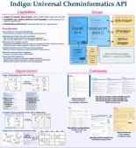
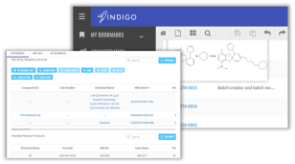
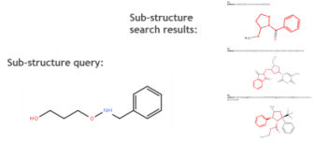
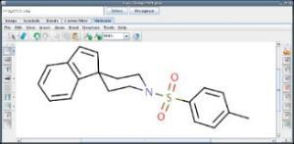
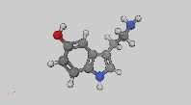
Open source products in Life Sciences
INDIGO TOOLKIT
INDIGO ELN
BINGO
Universal cheminformatics toolkit for solving such tasks as molecular fingerprinting, molecular search, molecule/reaction rendering, and molecular computations
Web-based chemistry electronic lab notebook allowing to create, store, retrieve, and share electronic records of chemistry and biology-related information
Flexible and scalable storage solution and search engine for chemical information stored in general molecular formats
KETCHER
IMAGO
MIEW
Web-based chemical structure editor: high performance, good portability, light weight, and easy integration into custom applications
Cross-platform chemical optical recognition library and utility for 2D chemical structure image recognition
Web-based 3D molecular viewer built on WebGL technology allowing for advanced visualization and manipulation of molecular structures
Notes:
And of course we have much more different open source products in life science domain
We already discussed today Indigo and Bingo, there is Ketcher – visual edtitor,
All of these products are fully open sourced, we are welcoming contributions, doesn’t matter where you work, it’s open source, it’s on Github, if you’re fancy NP full problems and life science background – come and join us ☺

Slide 36
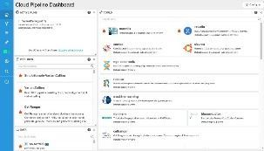
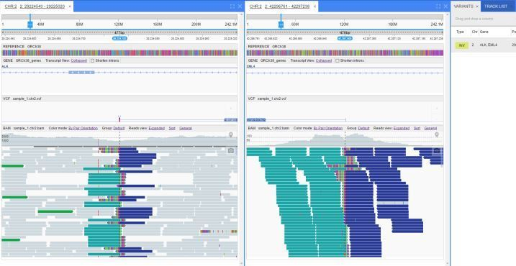
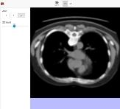
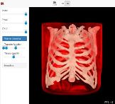
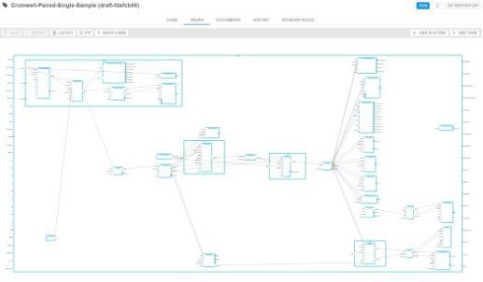
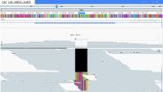
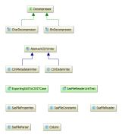
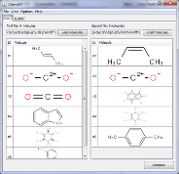
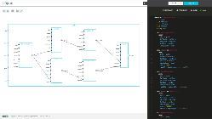
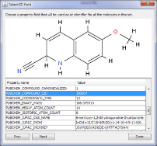
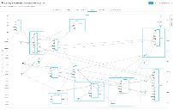
Open source products in Life Sciences
NEW GENOME BROWSER
WEB3D DICOM VIEWER
CLOUD PIPELINE
Fully customizable and interoperable solution for different scenarios of genome data visualization
High performance web tool for advanced visualization and manipulations over medical images such as MRI, CT, etc.
Web-based cloud environment to build and run customized scripts and workflows supporting genomics analysis, modeling and simulation, as well as machine learning to accelerate drug discovery research
PARSO
PIPELINE BUILDER
CHEMDIFF
Full-featured universal Java library designed to read uncompressed and CHAR-compressed SAS7BDAT files and convert data into CSV format
Web-based WDL builder providing visual editing capabilities for the creation and customization of bioinformatics workflows
Indigo-based utility for finding duplications and visual comparison of two files containing multiple structures
Notes:
And even more!

Slide 37
Useful links
https://github.com/epam/Indigo
https://github.com/epam/ketcher
https://www.elastic.co/guide/en/elasticsearch/reference/current/index.html
https://opendistro.github.io/for-elasticsearch-docs/
Johnson, A. M.; Maggiora, G. M. (1990). Concepts and Applications of Molecular Similarity. New York: John Willey & Sons. ISBN 978-0-471-62175-1.
https://www.daylight.com/dayhtml/doc/theory/theory.finger.html
https://www.rdkit.org/docs/index.html
https://open-babel.readthedocs.io/en/latest/index.html
https://cdk.github.io/
https://github.com/mcs07/docker-postgres-rdkit
http://help.accelrysonline.com/ulm/onelab/1.0/content/ulm_pdfs/direct/reference/ctfileformats2016.pdf#page34
https://github.com/MysterionRise/cheminformatics-toolkit-benchmark
https://github.com/MysterionRise/pubchem-finder
Notes:
Useful links, Indigo/Ketcher – open source products one being cheminformatics toolkit, including cartridges for popular DBs (like MySQL, Postgres) and now it have mentioned today Elasticsearch API, Ketcher – is visualization tool and drawing tool that could be used for drug design

Slide 38
Thank you!

